Slide 1


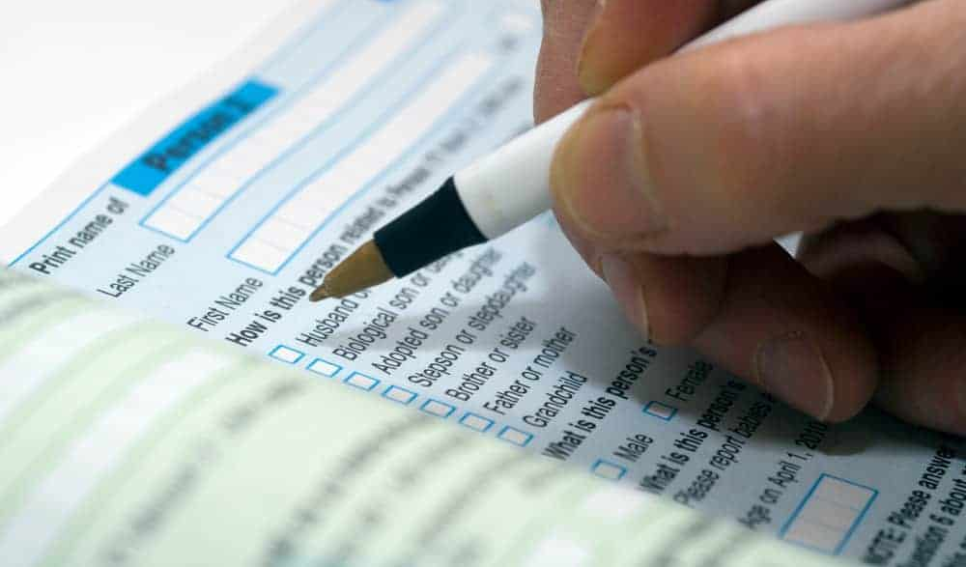
Census ???

Slide 2

Census Profiling Application
This Photo by Unknown Author is licensed under CC BY-NC-ND

Slide 3

Census Profiling Application Mentor: Mohammed Ishque Trainer: Sudheer Kumar
Presented By:
Team-1
Team Leader:
Atul Gajanan Jaware
Team Members:
Neelam Keerthi Yadav
Kondapalkala Manisha
Marlapalli Juhetha
Gadigantla Manisha
Vakiti Nandini

Slide 4
Introduction
This application captures information about the people residing in a particular village/town/city.
This Information related to their age, educational qualifications, kids and their interests.
This application focuses on gathering detailed information from persons of age groups.
The objective of gathering detailed information about this age group is to gather, collate, process and analyse the information for future requirements

Slide 5
Actors
Login
Application
Admin
User
Member
Address

Slide 6




Technologies
Spring Boot
JPA With Hibernate
Junit Testing
Postgres SQL
Tomcat Apache Server
Postman or Swagger
Gradle
SonarQube
Github

Slide 7
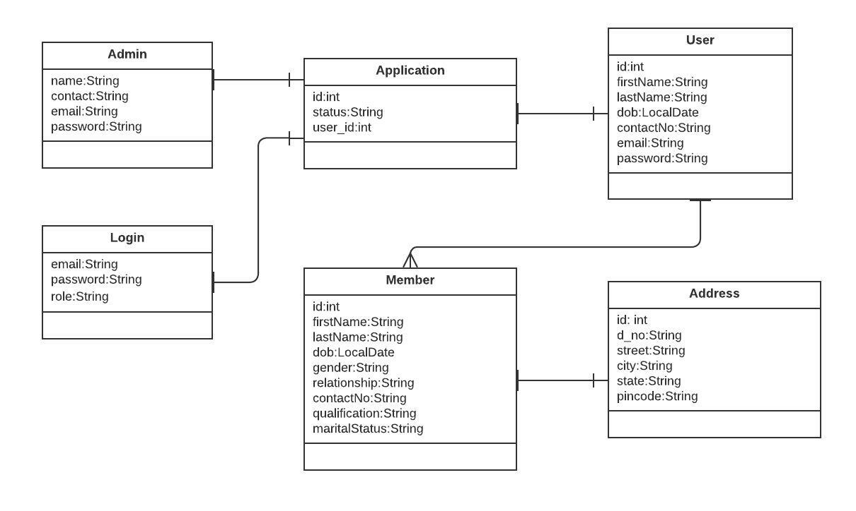
Class Design POJO Classes

Slide 8
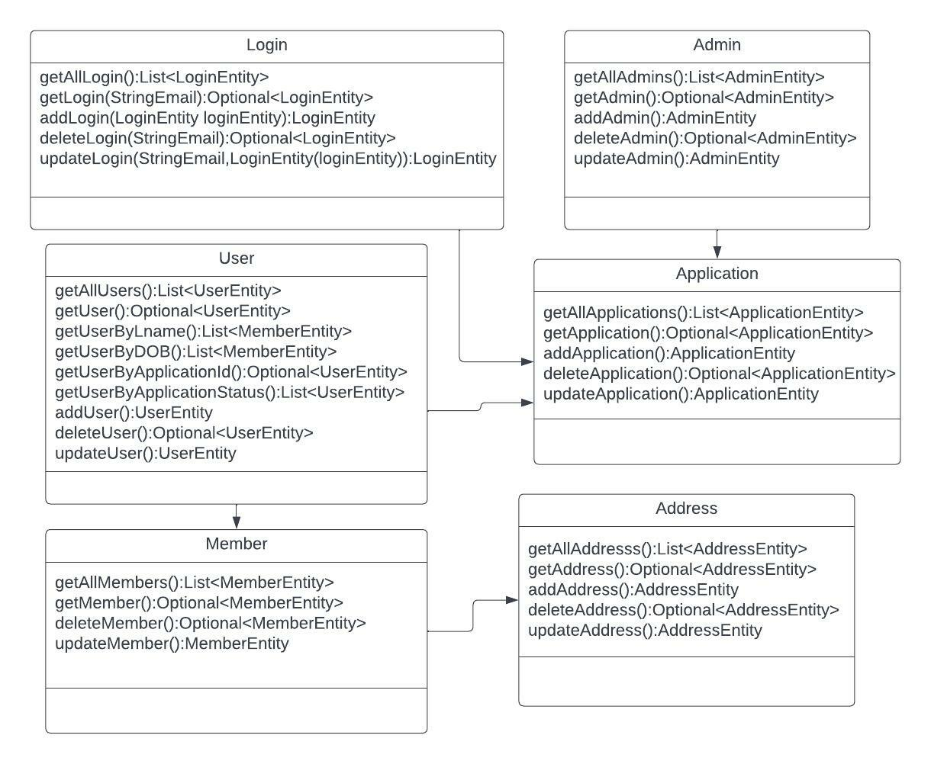
Services Interface

Slide 9
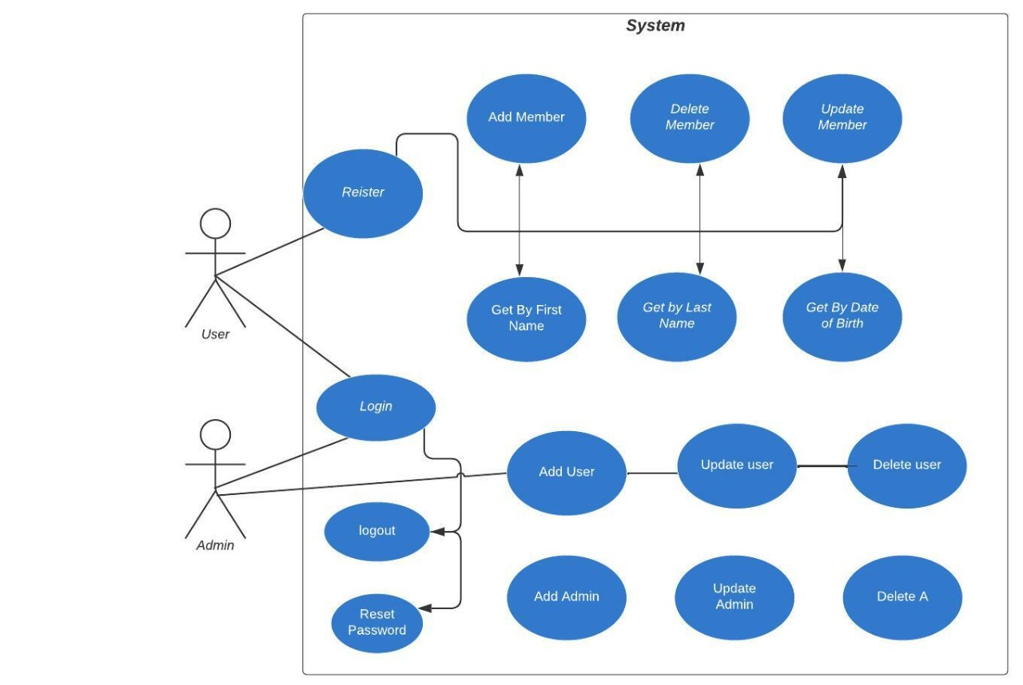
UseCase Design

Slide 10

THANK YOU

